Slide 1


Chapter 8
PHP Database
Department of E-Commerce
Faculty of Science and Information Technology
Kolej Universiti Islam Antarabangsa Selangor (KUIS)
http://www.kuis.edu.my/fstm

Slide 2


MySQL is the most popular open-source database system.
MySQL is a database.
The data in MySQL is stored in database objects called tables.
A table is a collection of related data entries and it consists of columns and rows.

Slide 3

A query is a question or a request.
With MySQL, we can query a database for specific information and have a recordset returned.

Slide 4
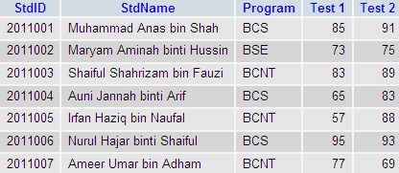
E.g.:
Table 1: StudentMark Table
SELECT StdName
FROM StudentMark;

Slide 5

Before you can access data in a database, you must create a connection to the database.
In PHP, this is done with the mysql_connect() function.
Syntax:
mysql_connect(servername, username,password);
E.g.: mysql_connect(“localhost”, “root”, “try123”);

Slide 6

The CREATE DATABASE statement is used to create a database in MySQL.
Syntax:
CREATE DATABASE database_name
To get PHP to execute the statement above we must use the mysql_query() function.
This function is used to send a query or command to a MySQL connection.

Slide 7

<?php
$db = mysql_connect("localhost","root","");
if (!$db)
{
die('Could not connect: ' . mysql_error());
}
if (mysql_query("CREATE DATABASE my_test_db",$db))
{
echo "Database created";
}
else
{
echo "Error creating database: " . mysql_error();
}
mysql_close($db);
?>

Slide 8

The previous example creates a database called my_test_db.

